Slide 1
A Journey to Remember
(A True to Life Story)

Slide 2
We think everything is set in our favor , but life puts many curves in our path. One small twist can bring an entirely different fate, But let us always remember that everything happens in our life for a reason.

Slide 3
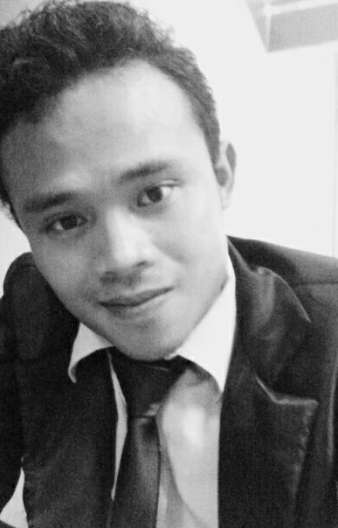
I’m JIM JOHN P. TOLENTINO
and was raise in a religious family. We are poor but we we’re happy living a simple life.

Slide 4
My parents are very supportive and they do & gave all their best for us.
And Sad to say , before I am an atheist I really don’t believe that God exist, because for me “to see is to believe”.
I just went to church before because of my parents. They want us to go all together.
But things changed when I was in high school.

Slide 5
At the age of 13 , I already stayed away from home. I’ve been staying at the dormitory of the school until my college days. I just went home once in every two months.
I’ve been influenced by my friends, I learn to have vices….

Slide 6
Smoking
Drinking

Slide 7
And I never went to church anymore…..

Slide 8
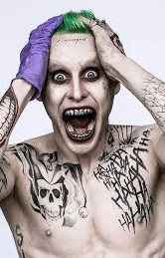
I’d really enjoy myself away from home and being troublesome.
HAHAHA…..

Slide 9
I was in ^{d} 2nd year college already at NONESCOST taking up the course of Bachelor of Science major in Physical Science when I stopped.
For the reason that I spent all the money in my vices which is supposed to be it was for my tuition.

Slide 10
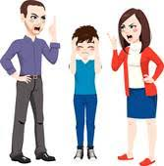

My parents got angry with me….

Slide 11
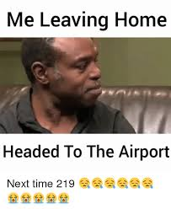

So, I decided to leave…..

Slide 12
I went to Dumaguete City to look for WORK…
2011
Sales Boy
Jollibee crew
Tutor
Call Center Agent

Slide 13
I experienced how hard LIFE is ….
alone…..
far away from home and
no communication with my families …. for more than 2 years.

Slide 14
INDEPENDENTLY
I lived with my own…

Slide 15
But One day something bad happened. I was rushed to the hospital. I got unconscious while working.

Slide 16
I found out I am sick!!!
The doctor said, A hyperthyroidism or overactive thyroid. He said that it has to be operated before it get worst.

Slide 17
I don’t know what to do and I’m so nervous.
But I kept saying to myself that …..
I will be fine…

Slide 18
I tried to take my medication for weeks, but it didn’t work…
I got easily collapse….. most of the time!

Slide 19
So, I decided to take a RISK for the operation…

Slide 20
October 6, 2014
I decided to went home after 2 years. . . . .

Slide 21
Mixed feelings and emotions…
Many tears….
Many questions… ???
Coz they can’t believed what happened to me….

Slide 22
Operation day.
And it was Successful….
October 8, 2014

Slide 23
A Life and Death Situation….
I was trying to get my phone when I feel down into the floor…
October 9, 2014
Bugshhhhhh!!!!

Slide 24
I saw fountain of blood coming from my neck …
I heard people screams…
and the cry of my father…

Slide 25
I was rushed to the operating room for the 2nd time.

Slide 26
And before everything gets black…
I heard My father said….

Slide 27
BE STRONG
HOLD ON
DON’T GIVE UP
PRAY

Slide 28
I knew in myself that I don’t believe in God that time… and
In my mind, if there’s GOD he will save me and I do promise I will serve Him for the rest of my life.

Slide 29
I Joined 1000 MISSIONARY MOVEMENT
I was SAVED
May 2015

Slide 30
THE BEST,
AND MOST UNFORGETTABLE
& HAPPIEST EXPERIENCED EVER.

Slide 31
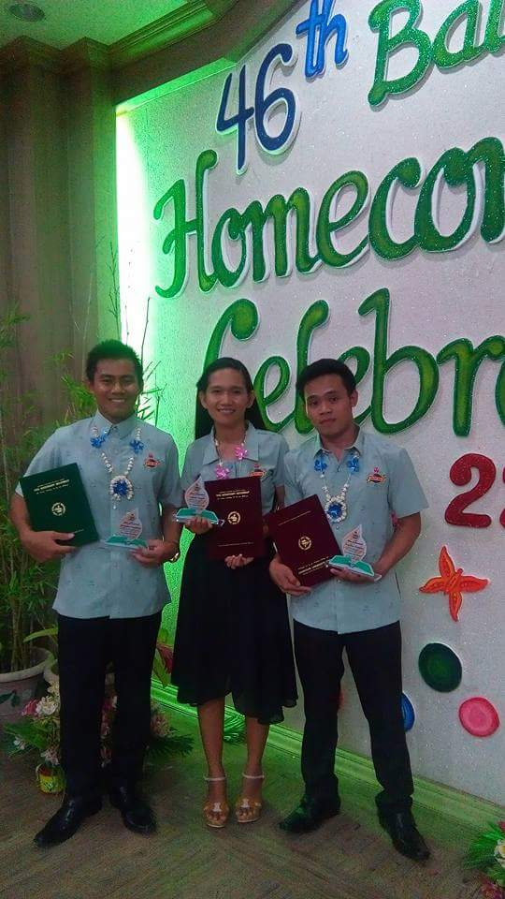
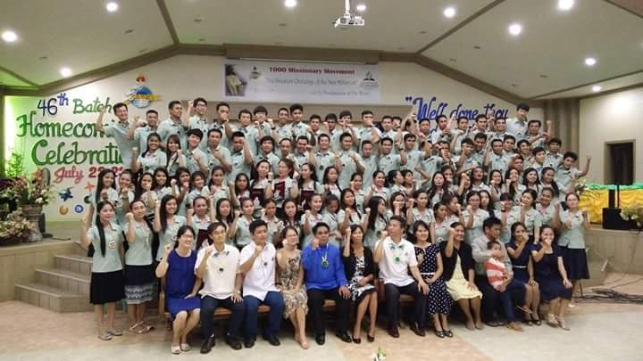
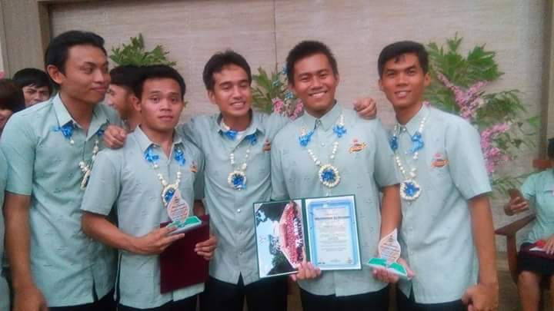
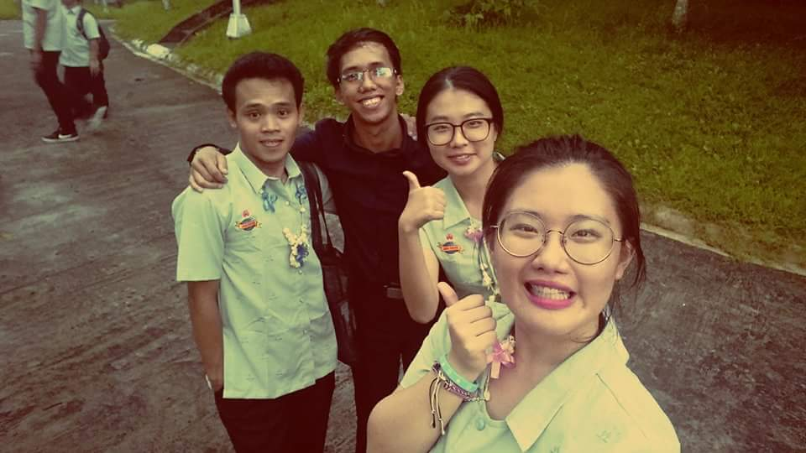
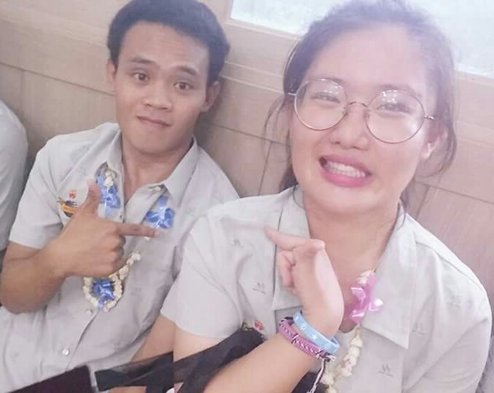
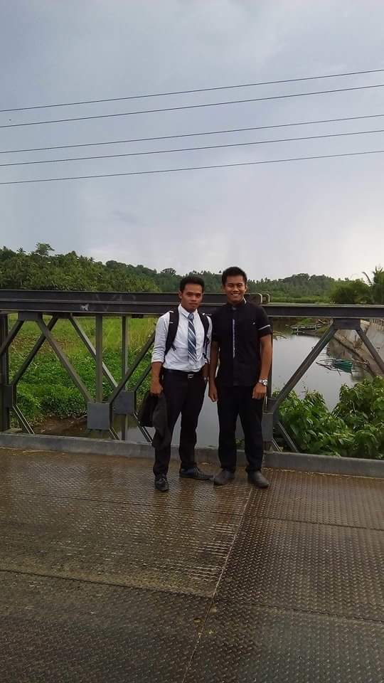

Slide 32
Everything happened is for a reason.
And I thank God that it happens to me.
What I am and who I am now because of my past.

Slide 33
I was REBORN for a new Life.
I changed…
I grew in faith… &

Slide 34
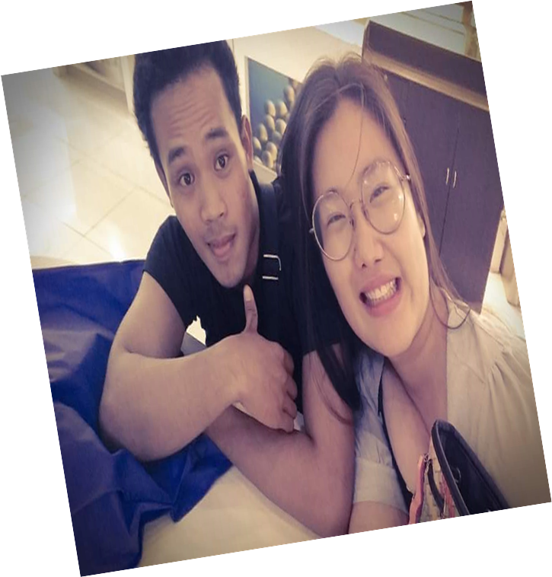


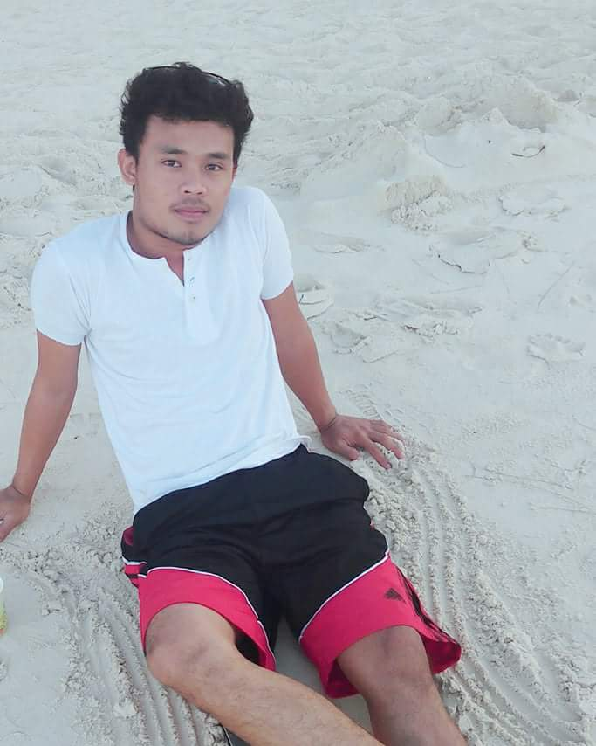

I became a new version of myself…

